Slide 1

MINI PROJECT JAVA(AI101B) Even Semester Session 2024-25
DIGITAL STEGANOGRAPHY
Group Members:
Rahul Rawat (202410116100159)
Priyanshu Asthana (202410116100154)
Prince Yadav (202410116100150)
Project Supervisor:
Mr. Vipin Kumar
Assistant Professor

Slide 2

Digital Steganography Using Java
This presentation explores the fascinating world of digital steganography, implemented using the Java programming language. Steganography allows hiding data in plain sight, offering a secure and covert communication method beyond traditional encryption. By embedding secret messages within digital images, we can protect sensitive information from unauthorized detection.

Slide 3
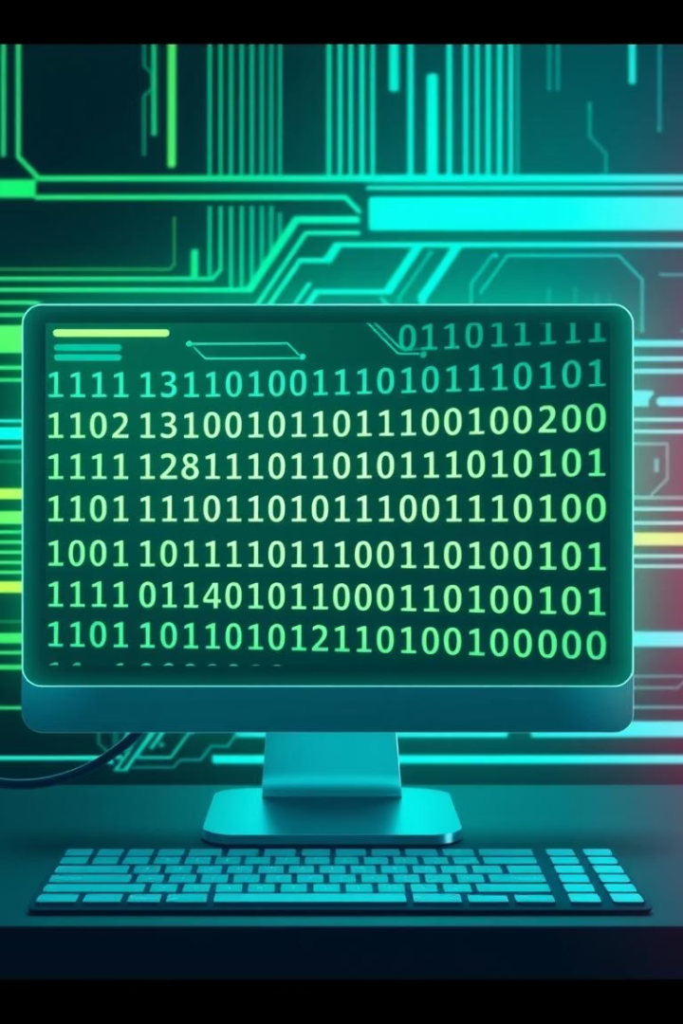
Presentation Outline
Digital Steganography Using Java
Introduction to Digital Steganography
Problem Statement
Project Objectives
Tools and Technologies Used
System Architecture
Key Features
Implementation and Usage
Challenges and Solutions
Results, Testing & Future Scope

Slide 4
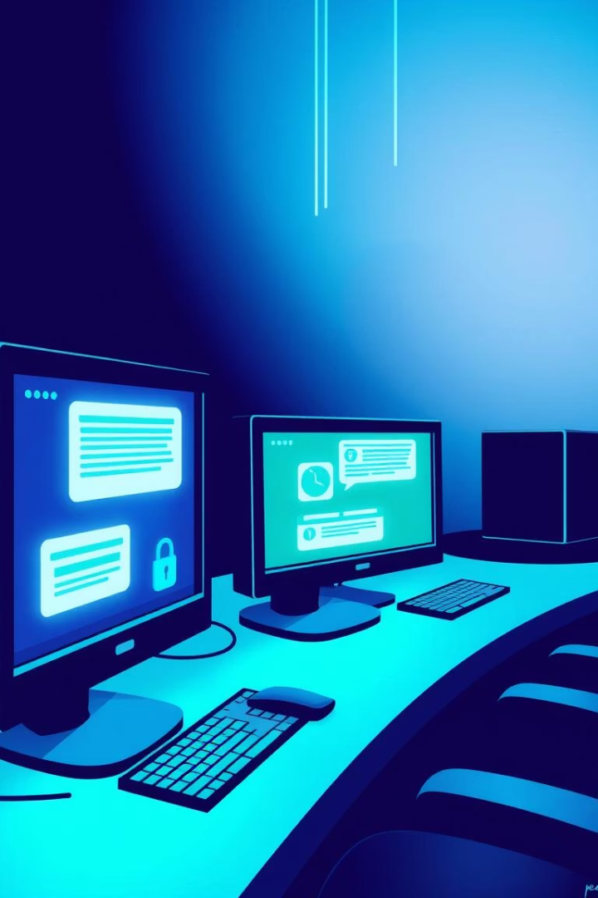
Introduction to Digital Steganography
Definition
How it Differs from Cryptography
Steganography is the art of hiding secret messages within other non-secret media, such as images or audio files, to achieve covert communication.
Unlike cryptography, which encrypts messages making them unreadable but visible, steganography conceals the existence of the message itself.
Significance
This technique adds an additional layer of security, helping to prevent detection and interception during digital communication.

Slide 5

Problem Statement
Challenge
Motivation
Secure communication methods often reveal the presence of encrypted data, which can attract unwanted attention or interception attempts.
Steganography offers a covert channel for secure data exchange, concealing messages inside innocuous media to avoid detection.
Impact
Data breaches cost US companies an average of $9.48M in 2023, highlighting the critical need for improved data security solutions.

Slide 6

Project Objectives
Implement Steganography
Develop a Java-based system to embed and extract secret data within image files securely.
Enable Secure Data Hiding
Focus on allowing users to hide messages in images without compromising the image quality or message integrity.
Develop User-Friendly GUI
Create an intuitive graphical interface to simplify image selection, message embedding, and extraction.
Ensure Data Recovery
Achieve a data recovery accuracy of at least 99% under ideal conditions through robust coding techniques.

Slide 7
Tools and Technologies Used
Programming Language
GUI Toolkit
Image Processing
Development Tools
Swing framework used to build a responsive and user-friendly graphical interface for seamless interaction.
Javax.imageio library facilitates reading, manipulation, and writing of image files during steganography operations.
IntelliJ IDEA or Eclipse IDE for coding efficiency
Java 17+ chosen for its robustness, portability, and extensive library support for image processing.
GitHub for version control and collaboration
Log4j for logging application debugging and operations

Slide 8

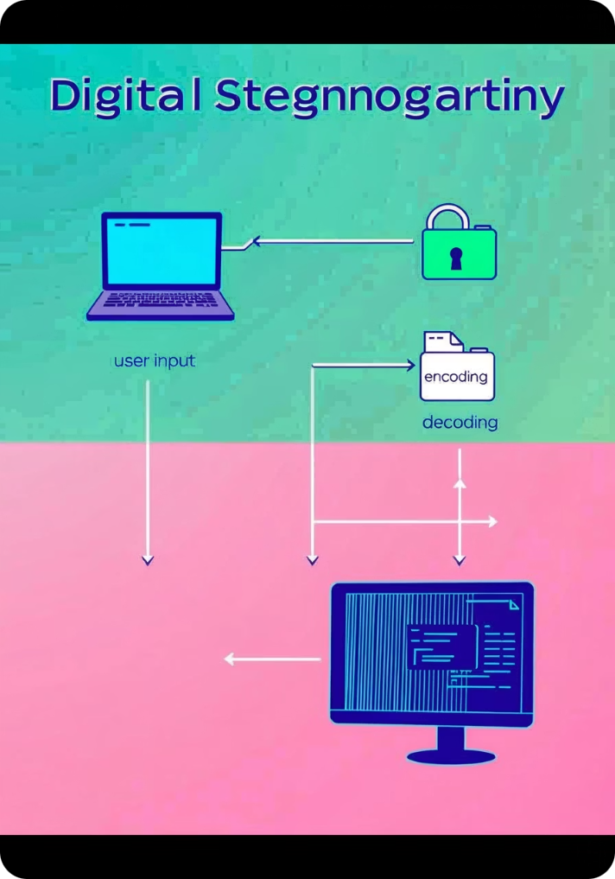




System Architecture
User Input
Users provide the image and secret message via an intuitive GUI interface.
Encoding
Java algorithm embeds the secret message into the image's least significant bits (LSB) for concealment.
Decoding
The system extracts the hidden message from the stego-image on user request.
File Management
Handles loading original images and saving the stego-images securely to disk.
This modular design ensures maintainability, scalability, and the seamless flow of data through all stages of the application.

Slide 9

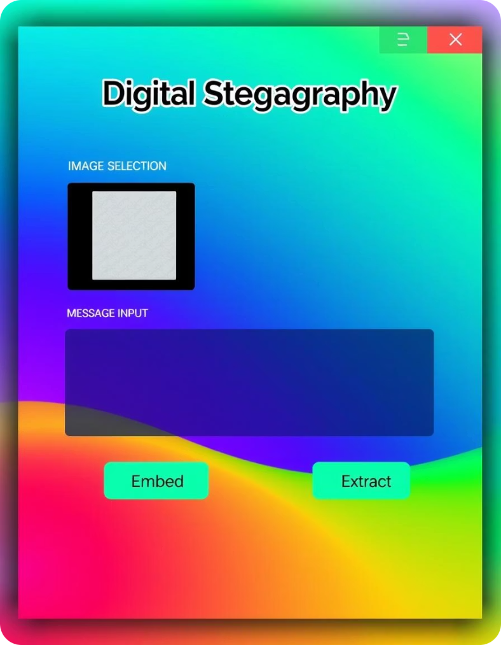




Key Features
Image Selection
Message Embedding & Extraction
Error Handling
Robust mechanisms handle exceptions gracefully, ensuring smooth user experience.
Browse and select supported image formats including PNG, JPG, and BMP.
Input secret messages to embed and extract them later with ease and accuracy.
User-Friendly GUI
Designed to be intuitive for users with varying levels of technical expertise.

Slide 10
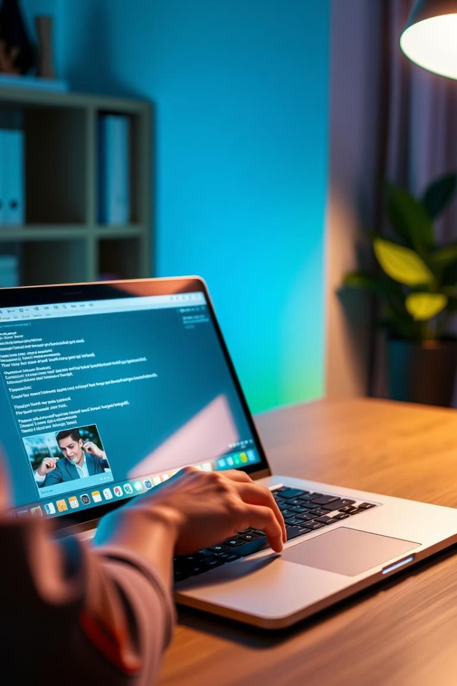
Implementation and Usage
1
Select Image
Users load an image file via the GUI file chooser dialog to prepare for embedding.
2
Enter Message
Type or paste the secret message into the provided text area, which is sanitized to prevent injection.
3
Embed Message
Click the "Embed" button to hide the secret data securely within the chosen image.
4
Extract Message
Load the stego-image and click “Extract” to retrieve the hidden message accurately.

Slide 11
Challenges and Solutions
File Corruption
Image Distortion
Large Message Handling
GUI Responsiveness
Implemented rigorous file validation and error detection mechanisms to prevent corrupted outputs.
Optimized encoding algorithms to minimize visible alterations, preserving image quality.
Used multithreading to ensure the user interface remains reactive during intensive processing tasks.
Applied Deflate compression to reduce message size by up to 50% and chunking techniques for efficient embedding.

Slide 12




Results, Testing & Future Scope
Data Recovery
1
Tested with 99.9% successful extraction rate, confirming reliability of embedded message retrieval.
Performance
2
Fast embedding and extraction, under 2 seconds for images below 5MB, supporting smooth user experience.
Compatibility
3
Cross-platform functionality supports Windows, macOS, and Linux environments.
Future Development
4
Planned enhancements include extending support to audio/video files, AI-driven detection avoidance, and mobile app deployment.

